Slide 1
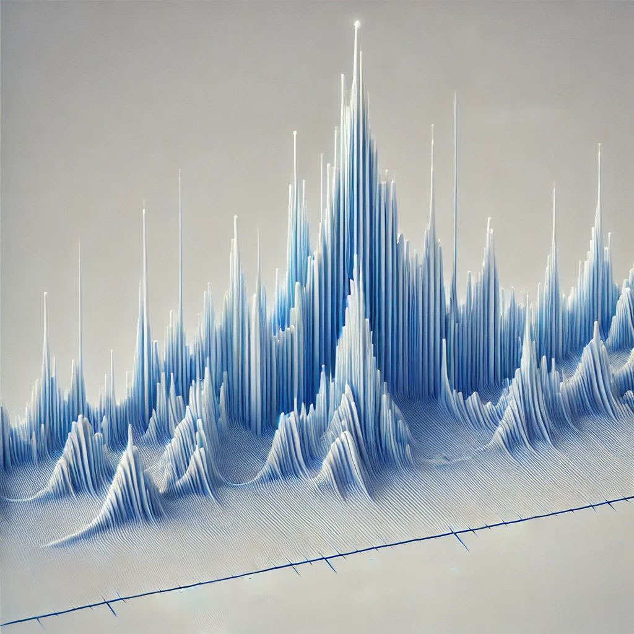
Rietveld Refinement of Powder Diffraction Data
ACerS Workshop: Tools for Visualizing and Understanding the Structure of Crystalline Ceramics
Taylor Sparks
Professor of Materials Science & Engineering, University of Utah

Slide 2


Download the software and tutorial materials now, the files are large
GSAS-II software
~400 MB download, 2 GB installed
Workshop tutorial materials
~30 MB

Slide 3
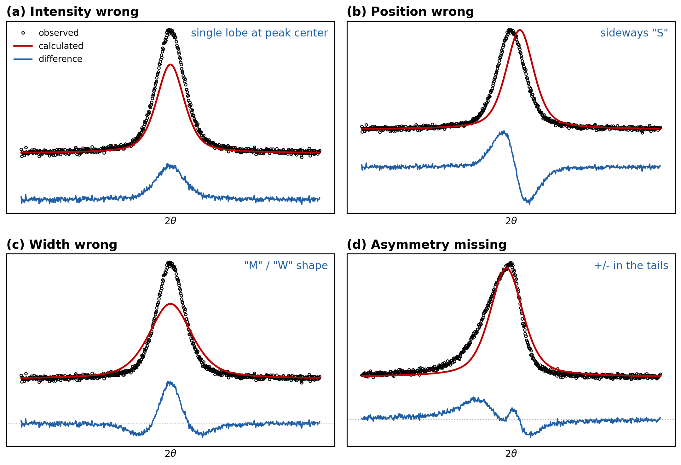
One technique answers many quantitative questions
What is Rietveld refinement and how does it work?
Quantitative analysis of multiphase mixtures
  Amorphous content
Atomic positions and site occupancy
Thermal displacement parameters
Preferred orientation
Crystallite size and strain

Slide 4
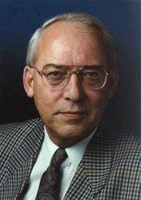
Rietveld refinement least-squares fits a calculated pattern to your data
Hugo Rietveld (1969)
Calculated pattern vs measured pattern
Variable model parameters, adjusted by least squares
Accounts for measurement errors (shift, zero offset)
Different from Le Bail or Pawley (profile) fitting: those fit intensities without a structure
Ab initio structure determination is a separate, harder problem
Notes:
Rietveld 1969. Emphasize: we fit the WHOLE pattern with a physical model. http://www.ccp14.ac.uk/poster-talks/rietveld-csiro-axaa-99/rietveld/index.htm

Slide 5
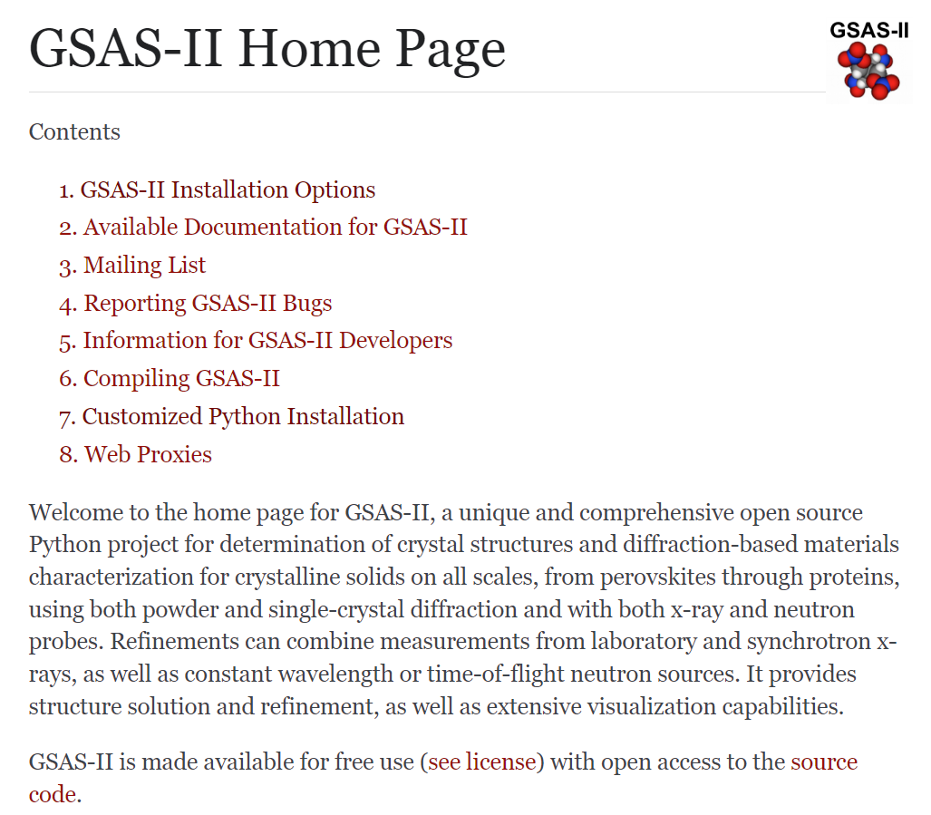
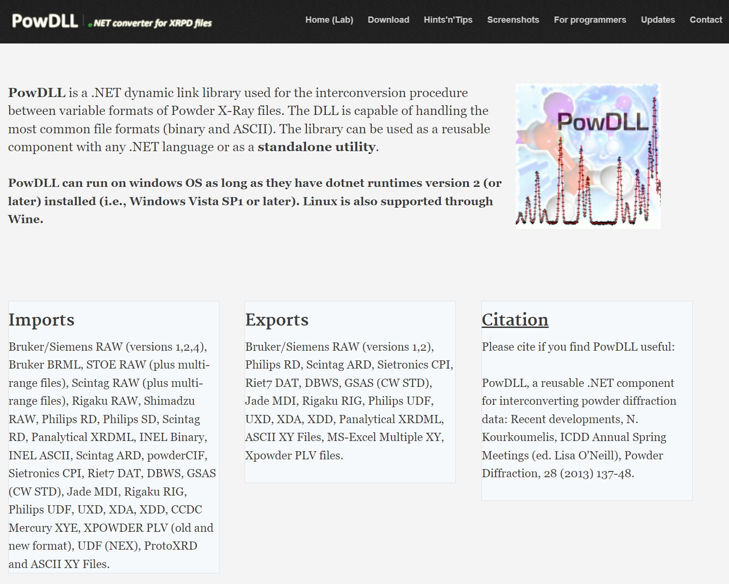
GSAS-II and PowDLL cover the whole workflow for free
Notes:
GSAS-II tutorials: https://advancedphotonsource.github.io/GSAS-II-tutorials/index.html PowDLL: http://users.uoi.gr/nkourkou/powdll/

Slide 6
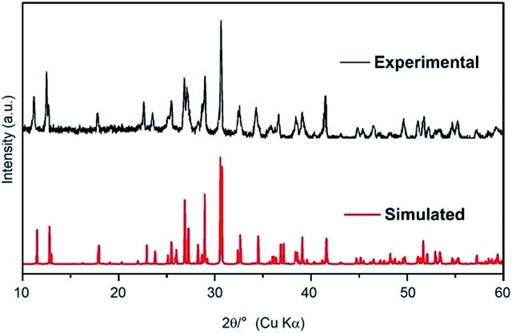
Modern software simulates powder patterns remarkably well

Slide 7
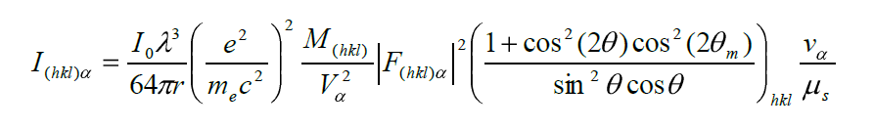
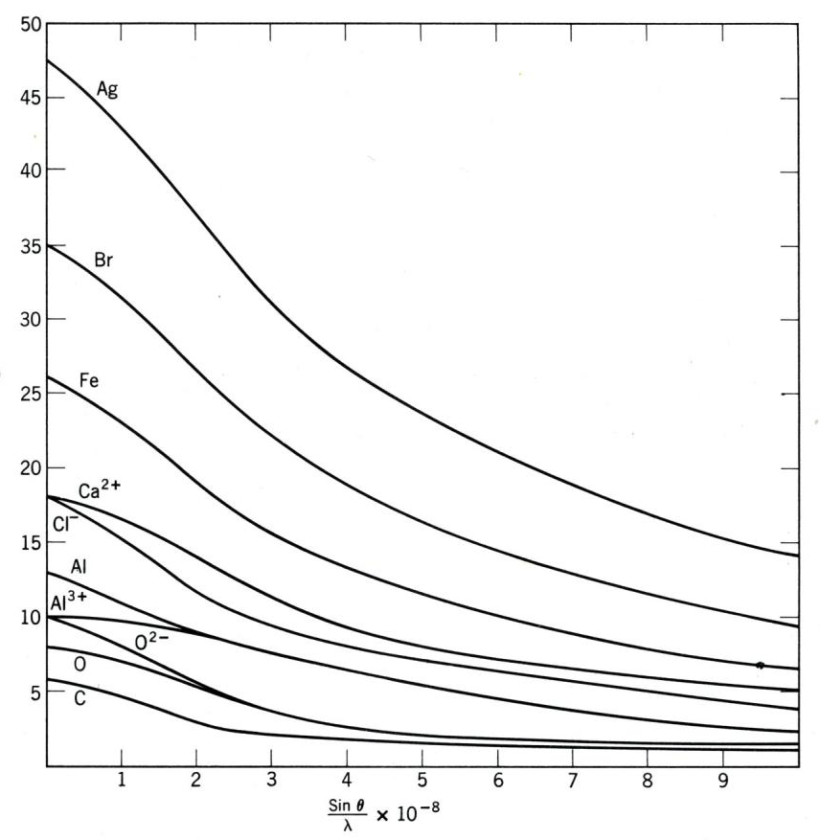


Peak intensity folds in source, sample, and structure factors
James R. Connolly, EPS400-001, Introduction to X-Ray Powder Diffraction, 2010
Notes:
I = incident intensity, geometry, absorption, phase volume fraction, multiplicity, Lorentz-polarization, unit-cell volume, and |F(hkl)|^2. Point at each factor: this is why intensities carry structural information.

Slide 8
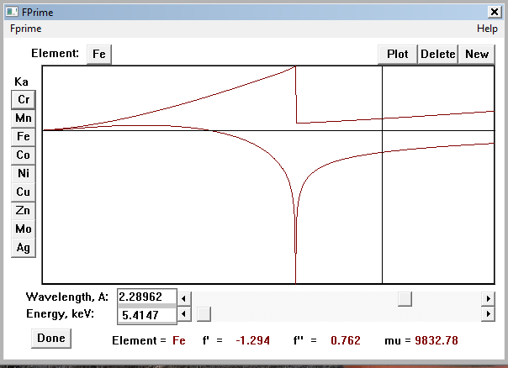
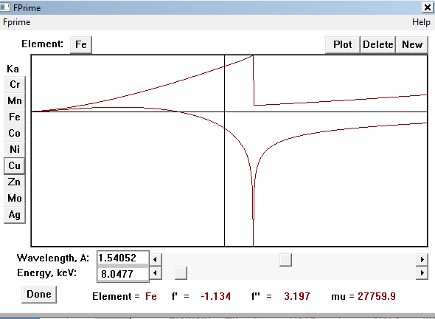
Radiation choice sets the anomalous scattering factors f' and f''
Notes:
https://www.xtl.ox.ac.uk/resources/software/fprime.html

Slide 9
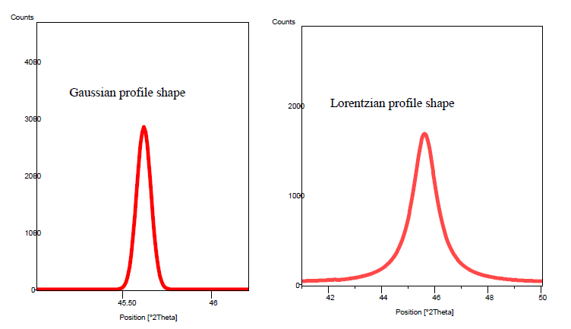

The instrument dictates Gaussian vs Lorentzian peak character
prism.mit.edu/xray/Rietveld_XRDSimulation.pdf

Slide 10
Every parameter changes the pattern in one of three ways
WHERE peaks sit
Lattice parameters (a, b, c, angles)
Zero offset
Sample displacement
WHAT SHAPE they have
Gaussian widths: U, V, W
Lorentzian widths: X, Y
Asymmetry (axial divergence)
Size and strain broadening
HOW TALL they are
Scale factor(s)
Atomic positions (x, y, z)
Site occupancies
Thermal parameters (Uiso, Uij)
Preferred orientation
Absorption, roughness
Diagnosis strategy: when the fit is bad, ask which bucket is wrong. Each bucket leaves a different fingerprint in the difference curve.
Notes:
Frame for everything that follows: every checkbox in GSAS-II lands in one bucket. Positions, shapes, or intensities. When a fit is bad, diagnose by bucket before touching anything.

Slide 11
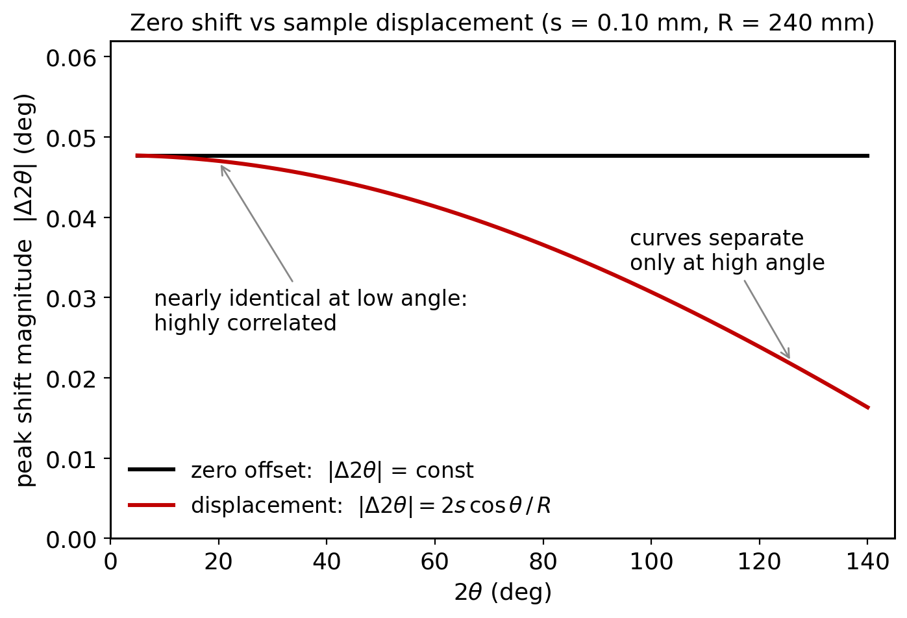
Peak positions must match before anything else can refine
Two rival corrections:
  Zero offset: Δ2θ = const.
  Displacement: Δ2θ = −2s cosθ/R
Nearly identical at low angle, so the two are highly correlated
Fix: internal standard (NIST Si 640) pins one of them
If positions are off, nothing downstream can converge (McCusker et al., 1999)
Notes:
Zero shift is constant; displacement dies off as cos(theta). Nearly identical below ~40 deg, so refining both from limited data is asking for trouble. Internal Si standard breaks the tie. McCusker: if positions are off, nothing else can converge.

Slide 12
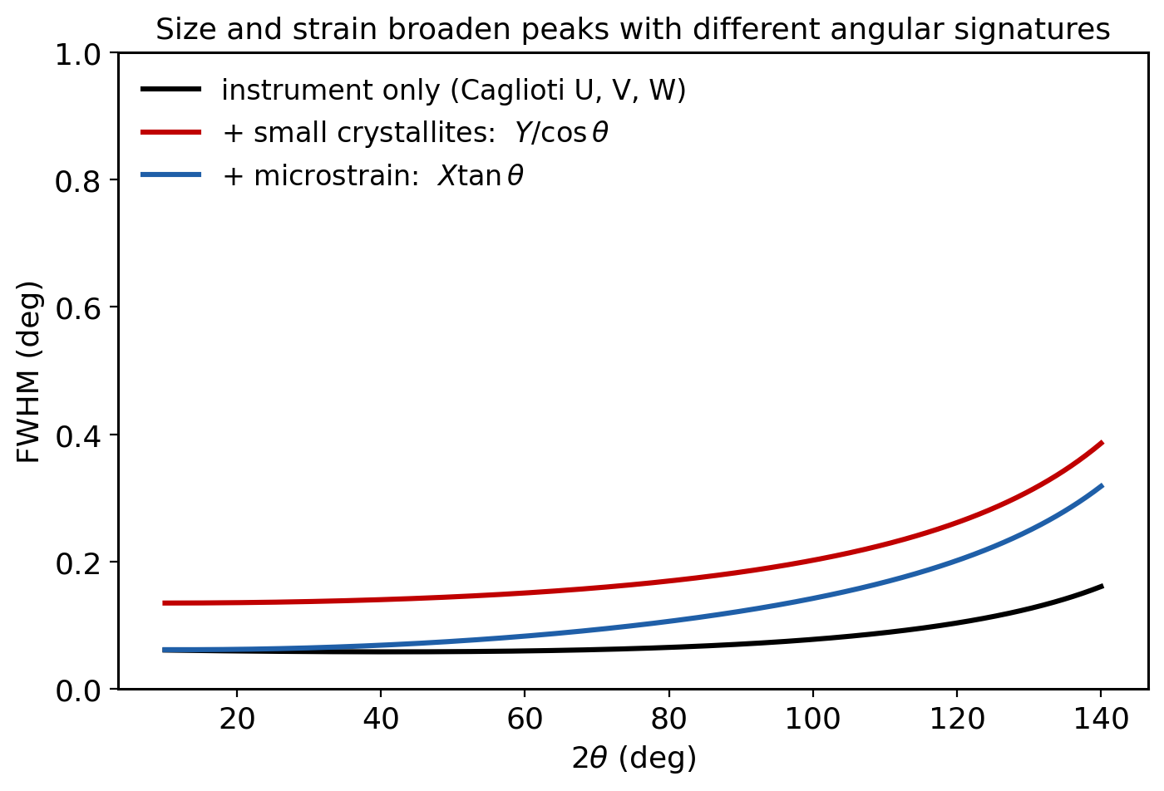
Peak widths encode real microstructure through U, V, W, X, Y
Gaussian part (Caglioti, 1958):
  FWHM² = U tan²θ + V tanθ + W
Lorentzian part:
  FWHM = X tanθ + Y / cosθ
X grows like strain broadening (tanθ)
Y grows like size broadening (1/cosθ, Scherrer)
Profile terms are physics, not fudge factors
Notes:
U, V, W set the Gaussian width; X and Y the Lorentzian. Key point: X goes as tan(theta) like strain, Y as 1/cos(theta) like Scherrer size. Characterize the instrument with a standard first; sample broadening is what is left over.

Slide 13
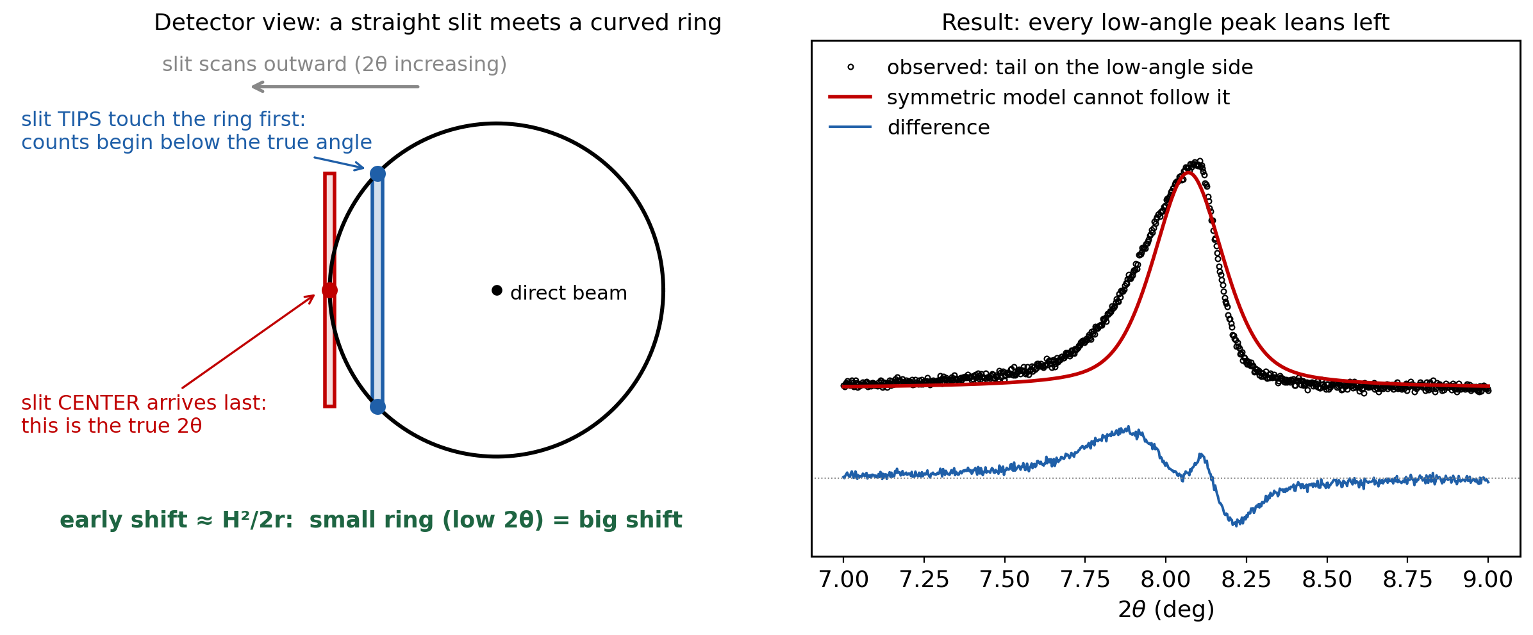
Axial divergence makes low-angle peaks lean; correct it, don't absorb it
Diffraction makes cones; on the detector they are rings, and low-angle rings are small and strongly curved
The receiving slit is straight and tall: scanning outward, its tips clip the ring before its center gets there, so counts arrive early and pile up on the low-angle side
The early shift scales as H²/2r, which is why the lean is worst at low 2θ (and on high-resolution instruments)
Model it with the Finger-Cox-Jephcoat correction (built into GSAS-II); never absorb it into peak width
Notes:
The Debye ring is curved, the slit is straight. At low angle the curvature within the slit smears counts to low 2-theta, so peaks lean left. Use the FCJ correction; if you fake it with extra width, sizes and strains come out wrong.

Slide 14
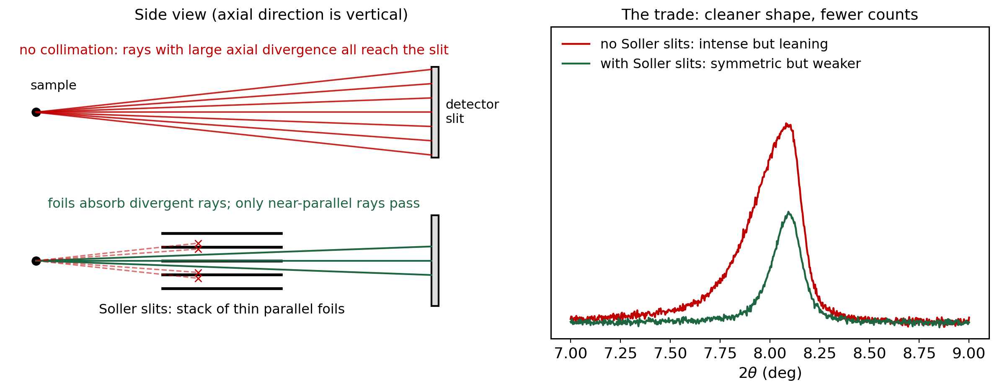
Soller slits tame axial divergence, at the cost of intensity
A stack of thin parallel foils limits out-of-plane divergence to roughly (foil spacing) / (foil length)
Less axial divergence = shorter low-angle tail and more accurate peak positions
The price is counts: every blocked ray is simply lost, so counting times grow
Some asymmetry always survives, so the Finger-Cox-Jephcoat correction still applies
Notes:
Hardware fix vs software fix. Soller slits shrink H in the H^2/2r shift, trading intensity for shape. Good instruments do both: collimate what you can, model what remains with FCJ.

Slide 15
The difference curve tells you which parameter is wrong
Real misfits are superpositions of these four fingerprints (after McCusker et al., J. Appl. Cryst. 32, 36, 1999)
Notes:
The money slide. Intensity error: single lobe. Position error: sideways S. Width error: M or W. Missing asymmetry: wiggle in the tails. Real refinements superpose these. Have audience call out the fingerprint for each panel.

Slide 16
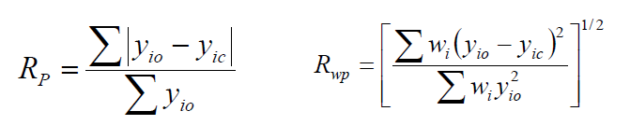
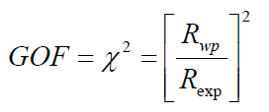
Rp, Rwp, and chi-squared put numbers on the fit
Rp: plain difference between observed and calculated intensities
Rwp: weighted, so strong peaks matter more than weak ones; this is what least squares minimizes
Common guideline: Rwp < 10% or χ² < 4 for a good fit
prism.mit.edu/xray/RietveldGOF.pdf

Slide 17
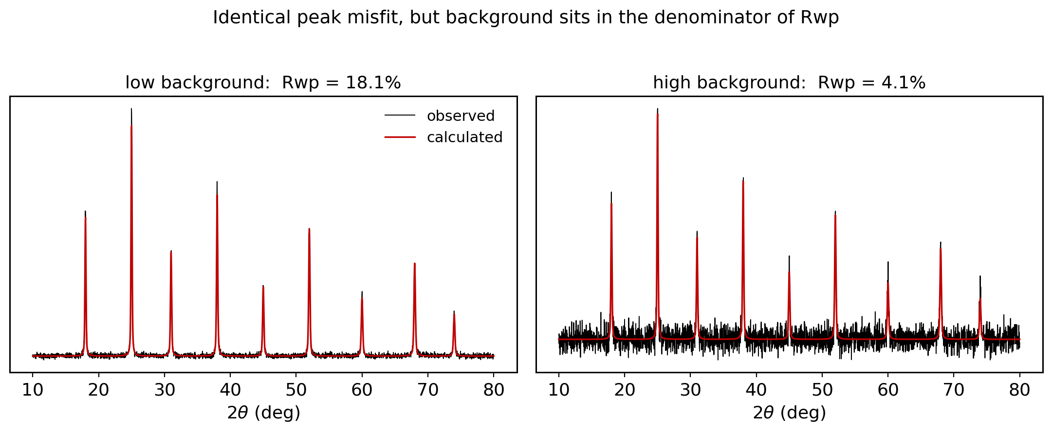
A good Rwp can hide a bad fit, and vice versa
Background sits in the denominator: high background flatters Rwp for the very same peak misfit
Never compare Rwp across instruments: TOF neutron at 3% and lab XRD at 10% can be equally good fits
Your floor is the Le Bail Rwp; judge fits with the plot and chemical sense, not the number (Toby, 2006)
Notes:
Both panels have the identical peak misfit; only the background changed, and Rwp fell from 18 to 4 percent. Moral: Rwp is not comparable across experiments. The Le Bail fit is your floor. Judge with the plot and chemistry (Toby 2006).

Slide 18
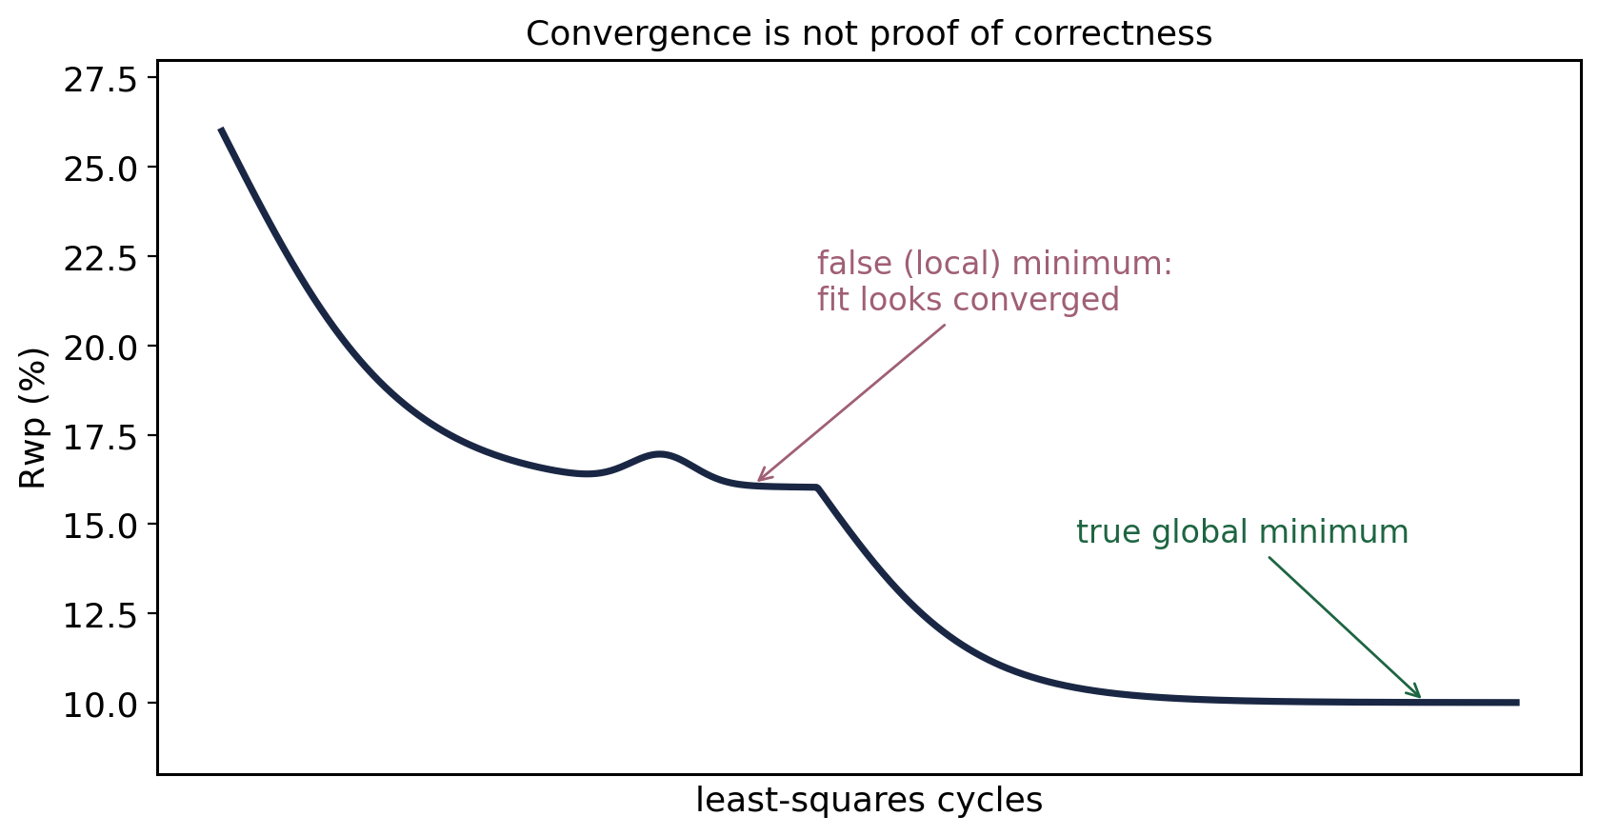
Convergence to a minimum is not proof you found THE minimum
"A Rietveld refinement is never finished, only abandoned." P. W. Stephens
Notes:
Run cycles in small batches, watch shift/esd, and be willing to back out. A flat Rwp can be a shelf, not the floor.

Slide 19
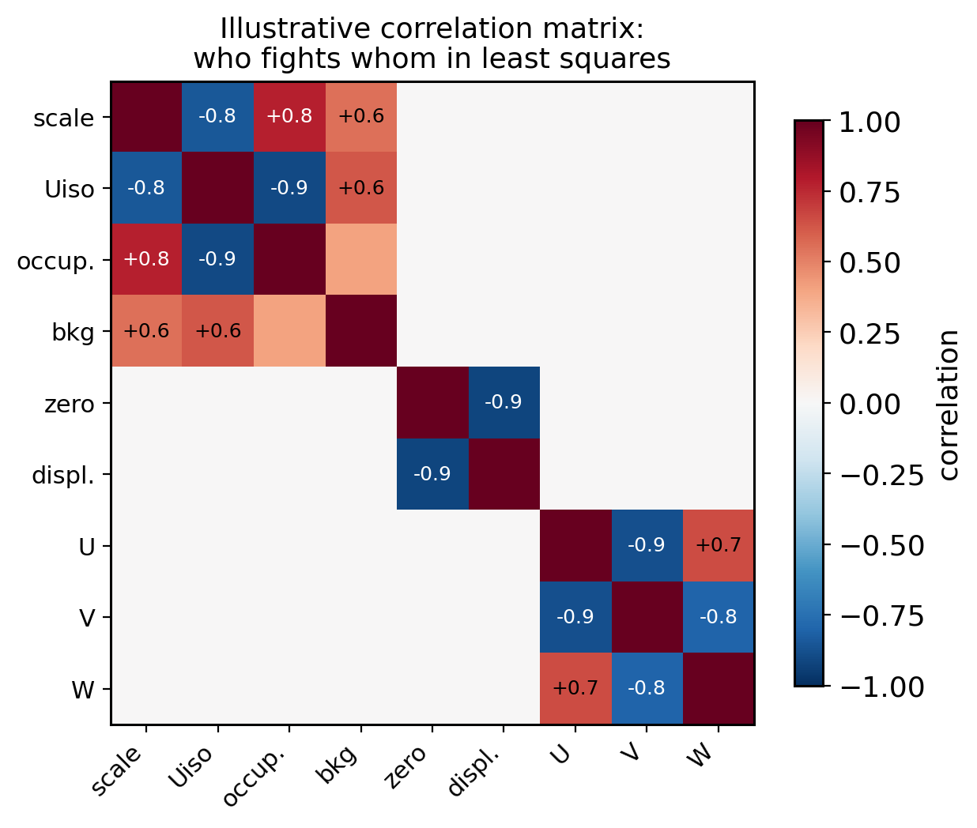
Refinement turn-on order is correlation management
1. Scale + background
2. Lattice + zero (or displacement)
3. Profile: W first, then U, V, X, Y
4. Positions: heavy atoms, then light
5. Uiso (constrain similar atoms early)
6. Occupancies last, then all together
Rule of thumb: observations per parameter ≥ 3, ideally 5
Notes:
The recipe is correlation management: free the parameters that move the residual most and fight least, first. Heat map shows the usual suspects: scale vs Uiso vs occupancy, zero vs displacement, U vs V vs W. End with the 3-to-5 observations-per-parameter rule.

Slide 20
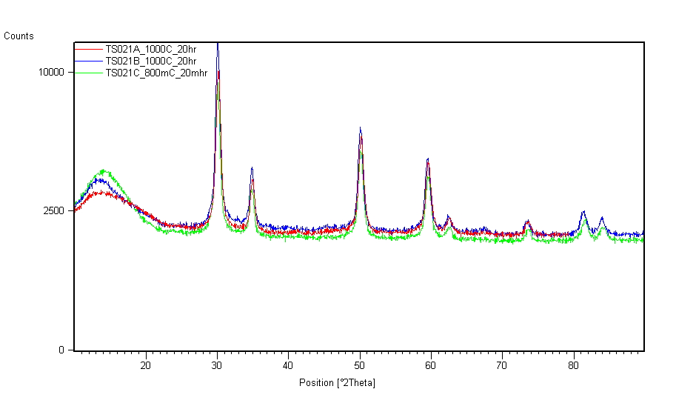
Multiphase analysis starts by matching the peak list to phases

Slide 21
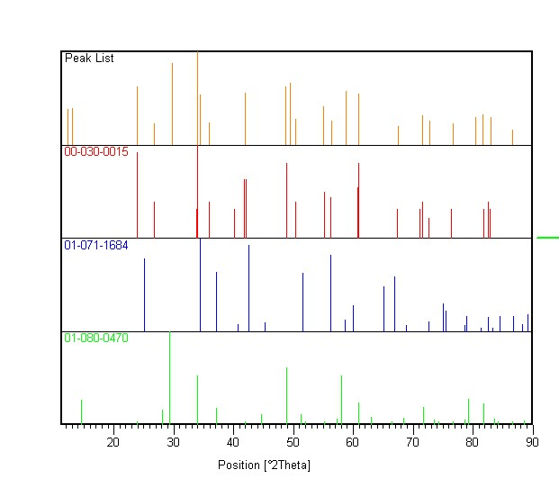
A three-phase Rietveld fit resolves the mixture directly

Slide 22
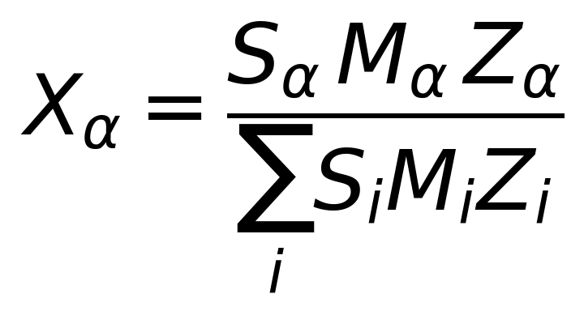
The SMZ relation converts scale factors into weight fractions
S is the phase scale factor, proportional to the number of unit cells measured
M is the molecular weight
Z is the number of formula units per unit cell
The product SMZ is proportional to the concentration of each phase

Slide 23
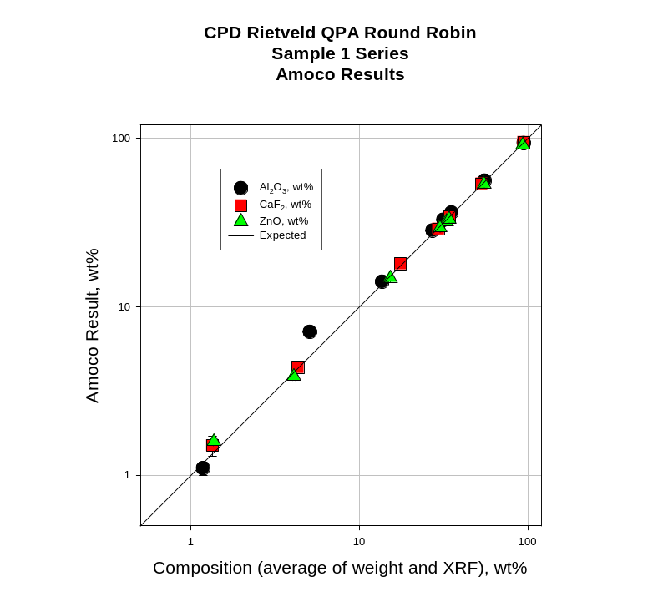
Round-robin studies show quantitative analysis is accurate to a few percent
James Kaduk, ICDD, Rietveld Refinement Workshop, Oct 2010
Notes:
CPD Rietveld QPA round robin, Amoco results. https://journals.iucr.org/j/issues/2001/04/00/hw0085/hw0085.pdf

Slide 24
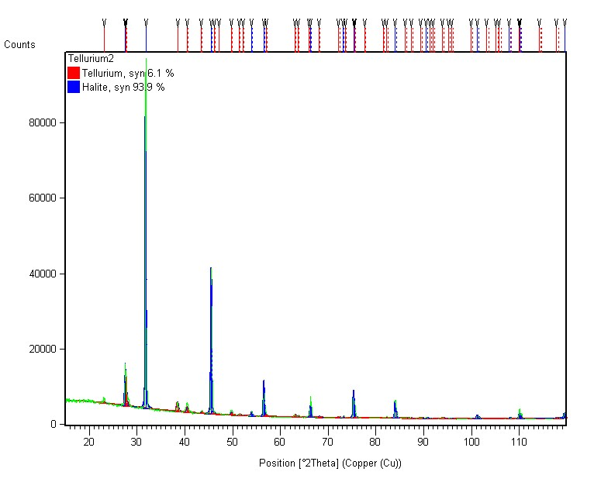
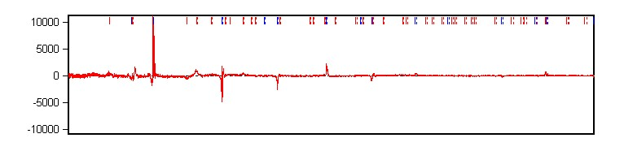
Rietveld quantifies 6% tellurium recovered from a seawater medium
93.9% NaCl
6.1% Te
Rwp = 6.9%
Error sources: absorption (transparency), sample volume (more powder)

Slide 25
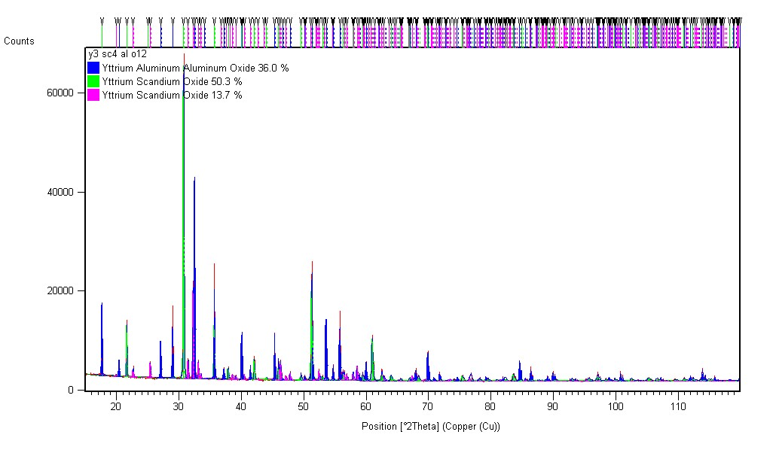
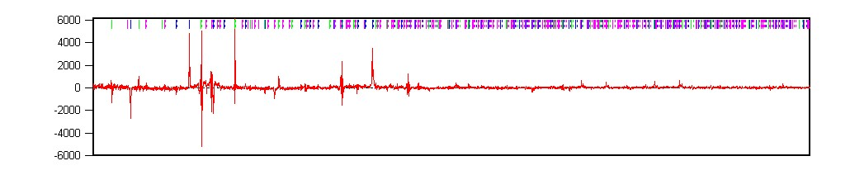
The intended Y3Sc4AlO12 actually crystallized as three phases
36% YAG (Ia-3d)
50.3% YScO3 (Ia-3)
13.7% YScO3 (Pnma)
Rwp = 5.3%

Slide 26
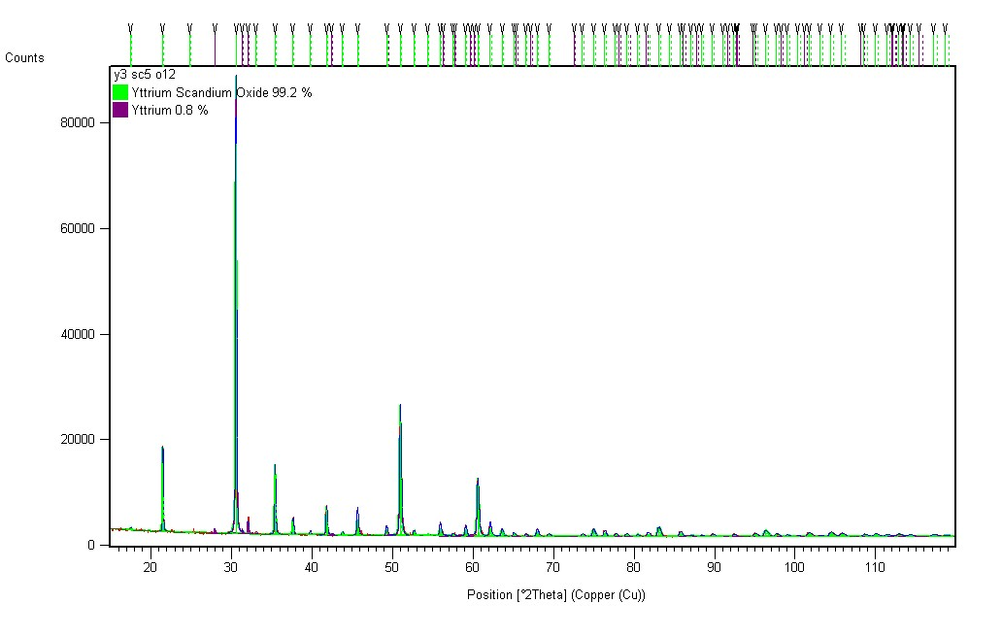
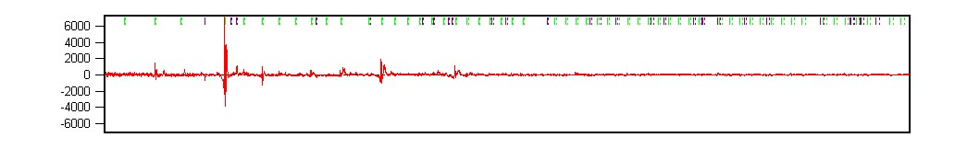
Y3Sc5O12 instead formed nearly phase-pure bixbyite
99.2% Y3/4Sc5/4O3 (Ia-3)
0.8% Y (P63/mmc)
Rwp = 4.7%

Slide 27
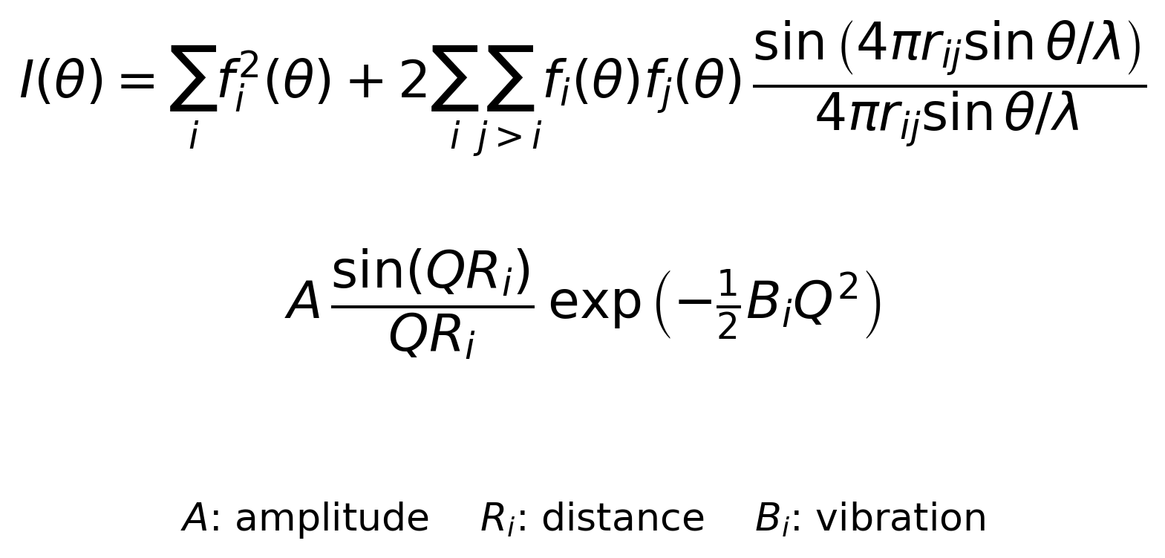
The Debye equation extends analysis to amorphous content
Percent amorphous material can be determined if a standard is added in a known amount
Terms describe interatomic distance and vibration amplitude
A radial distribution function is needed to determine bond distances for analysis

Slide 28
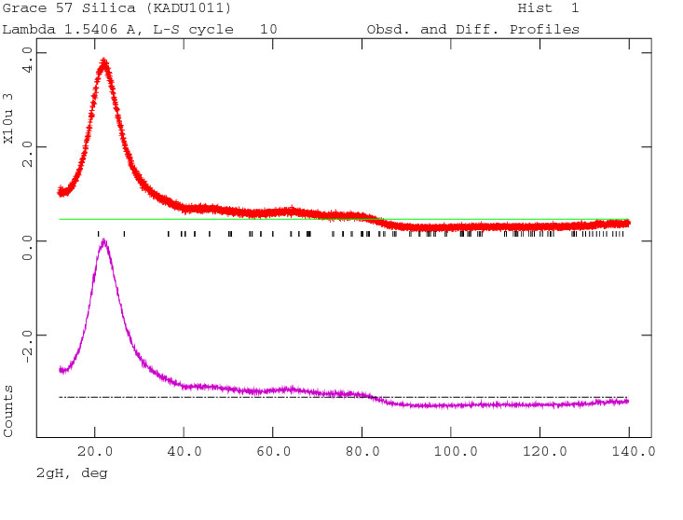
Glassy silica's diffuse scattering can be fit, not just subtracted
James Kaduk, ICDD, Rietveld Refinement Workshop, Oct 2010

Slide 29
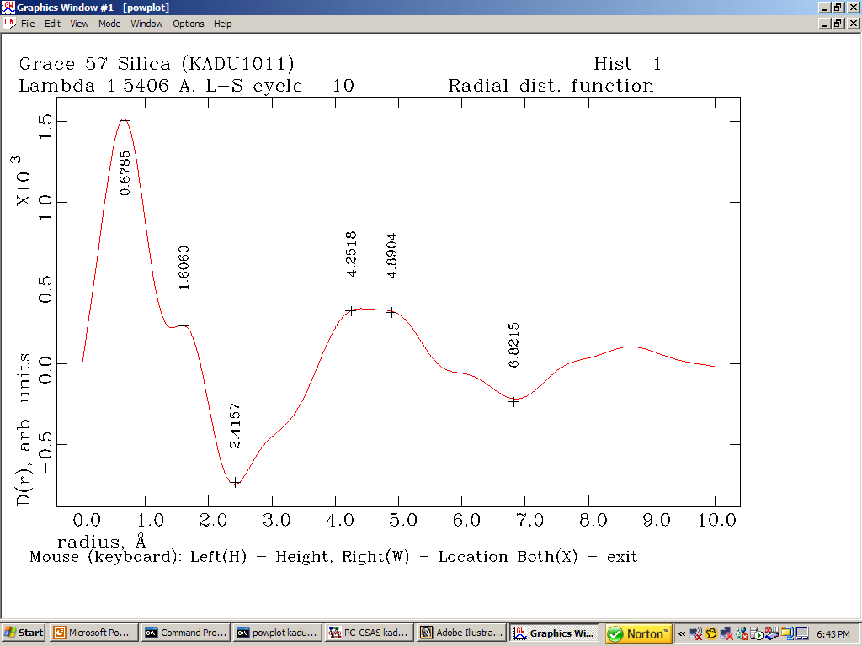
The refined model yields a real-space radial distribution function
James Kaduk, ICDD, Rietveld Refinement Workshop, Oct 2010

Slide 30
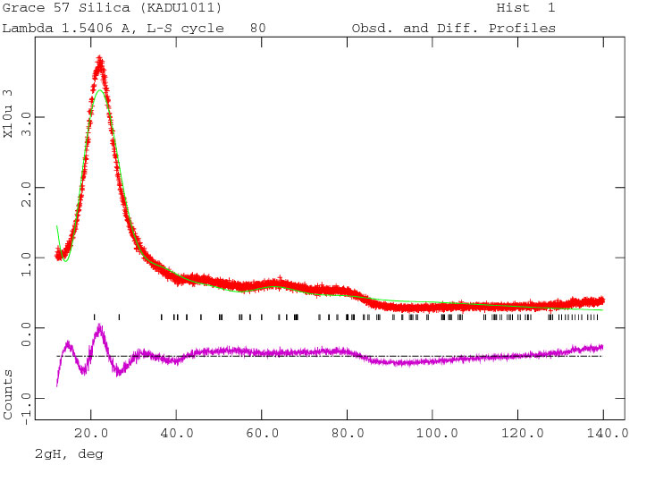
Iterating the Debye model steadily improves the diffuse fit
James Kaduk, ICDD, Rietveld Refinement Workshop, Oct 2010

Slide 31
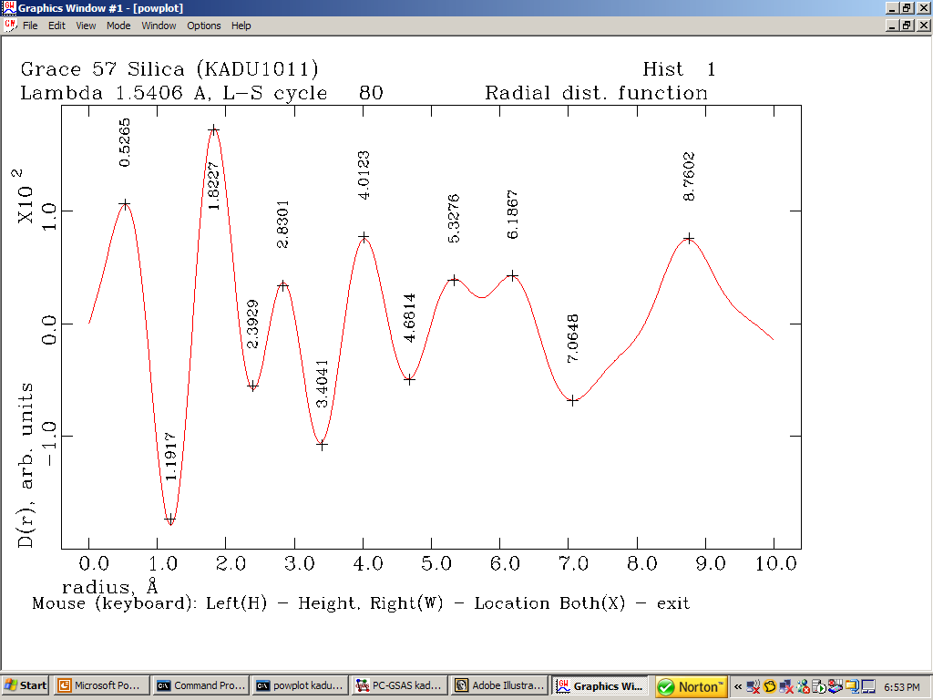
RDF peaks index directly to coordination shells
James Kaduk, ICDD, Rietveld Refinement Workshop, Oct 2010

Slide 32
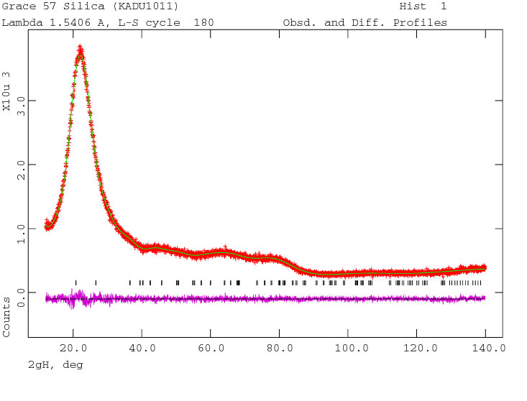
The final diffuse fit converges with chi-squared = 1.11
James Kaduk, ICDD, Rietveld Refinement Workshop, Oct 2010

Slide 33
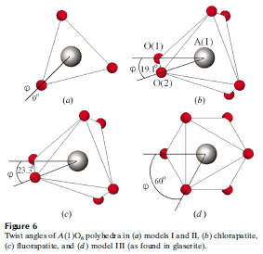
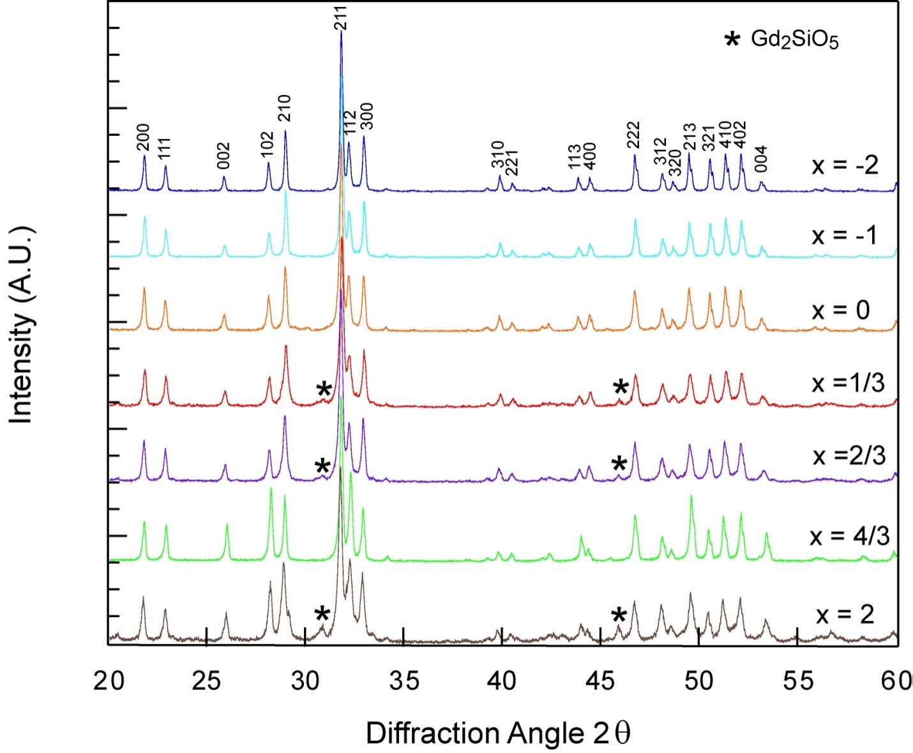
Lab XRD alone cannot settle apatite site occupancies
Gd8+xCa2+y(SiO4)6O2+3x/2+y system with anion/cation vacancies
Lab XRD is insufficient to answer:
  Impurity wt%?
  Volume change?
  Cation site preference?
  Meta-prism twist?
Notes:
White et al., Structural derivation and crystal chemistry of apatites, Acta Cryst. B59, 1-16 (2003)

Slide 34
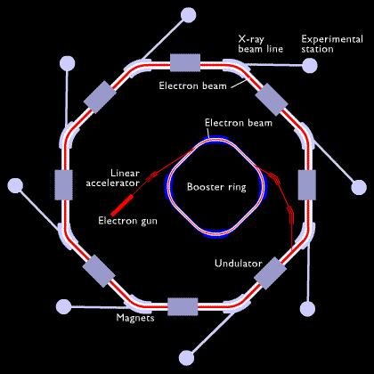
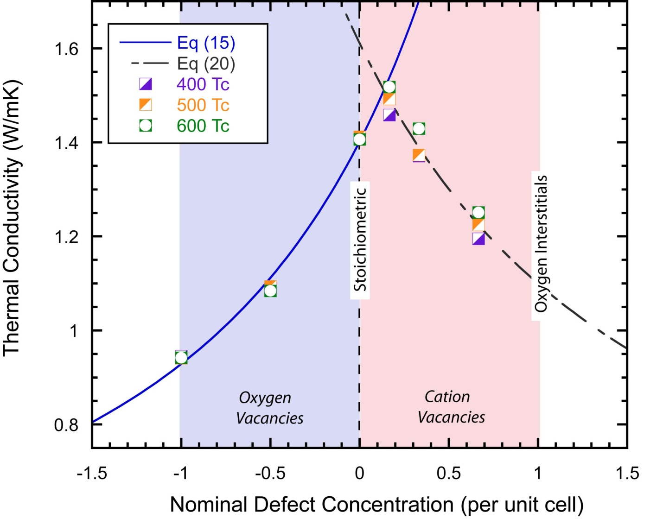
Synchrotron data adds the resolution occupancy refinement needs
Stoichiometric composition should have the highest thermal conductivity
  Phase separation?
Synchrotron diffraction brings:
  Improved signal-to-noise ratio
  Improved resolution
  Minimized anomalous scattering

Slide 35
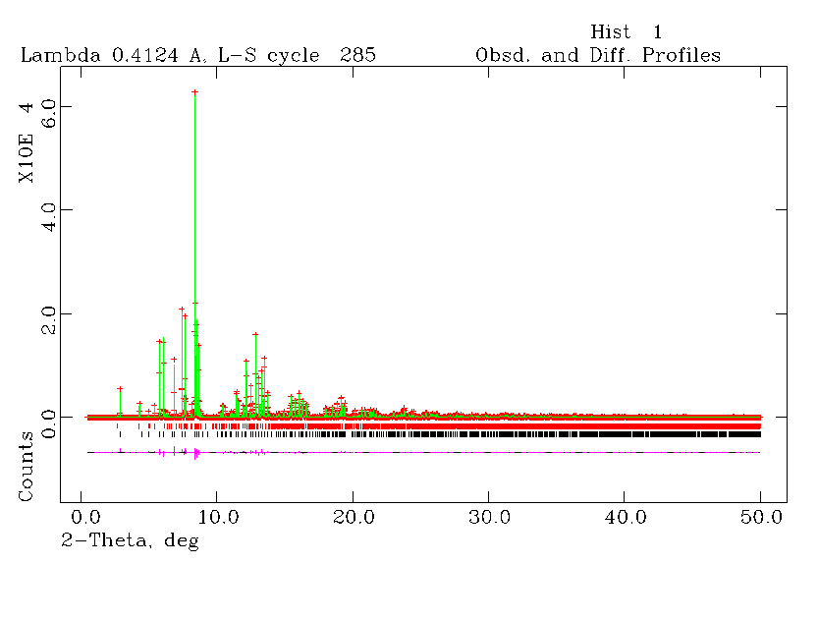
Refinement finds 5% Ca on A1 and a 23.6 degree meta-prism twist
Rwp = 6.29%
85% Gd7.7Ca2.3(SiO4)6O2
14% Gd2SiO5
Ca has ~5% on A1
Meta-prism twist 23.6°
Initial composition Gd8.333Ca1.5(SiO4)6O2

Slide 36
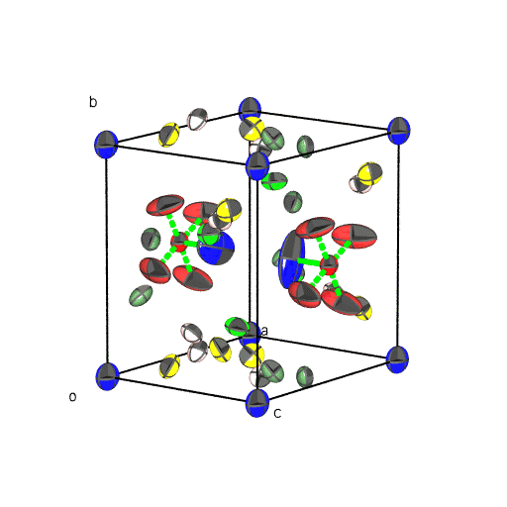
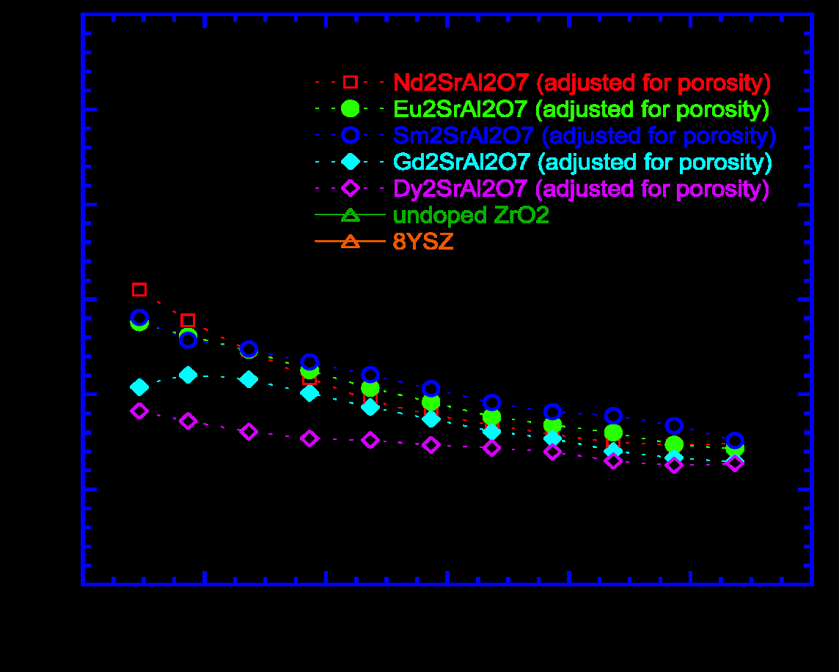
Large refined Uiso values can flag rattling atoms
Thermal vibrations are quantitatively studied in Rietveld refinement
  Uiso, or Uij for anisotropic vibration
Large U values could be due to rattling
  An explanation of RE2SrAl2O7 thermal conductivity?

Slide 37
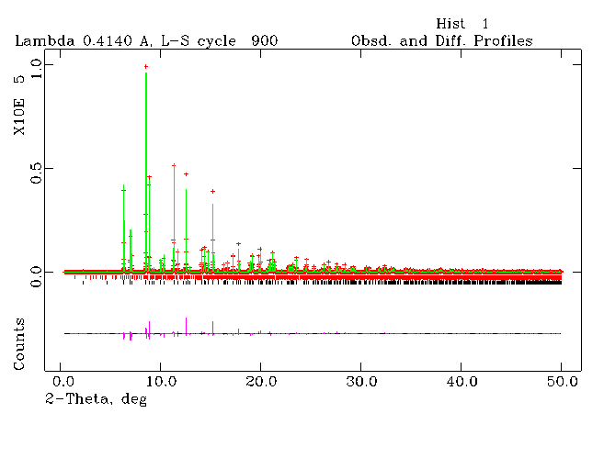
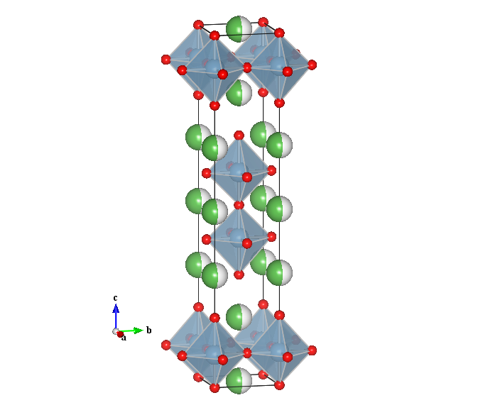
Occupancy and Uiso trends track across the RE2SrAl2O7 series
Composition | La2SrAl2O7 | Nd2SrAl2O7 | Sm2SrAl2O7 | Eu2SrAl2O7 | Gd2SrAl2O7 | Dy2SrAl2O7
Uiso A1 | 0.11(2) | 0.21(5) | 0.40(3) | 0.20(1) | 0.37(3) | 0.96(2)
A1 (P2) occupancy | .73 | .54 | .43 | .32 | .25 | .21
A2 (RS) occupancy | .27 | .46 | .56 | .67 | .72 | .79

Slide 38
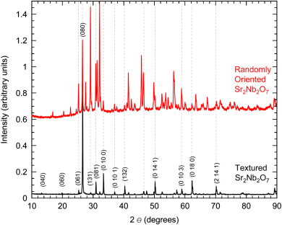
Texture is obvious by eye; Rietveld puts a number on it
Sr2Nb2O7: clearly textured to the b-axis, but what is the preferred orientation factor?

Slide 39
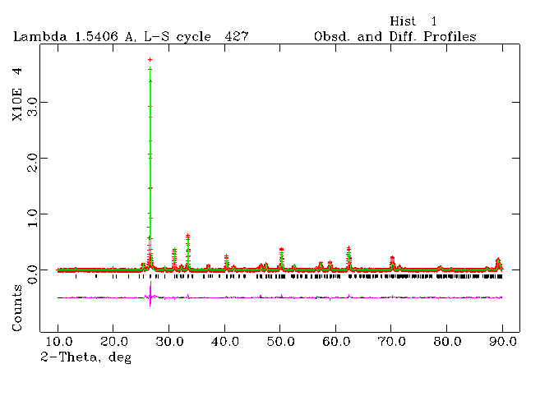
March-Dollase refinement gives Sr2Nb2O7 a texture index of 5.52
Rwp = 6.9%
Texture index = 5.52
Note: the actual compound had a small amount of La3+ doped on the Sr2+ site

Slide 40
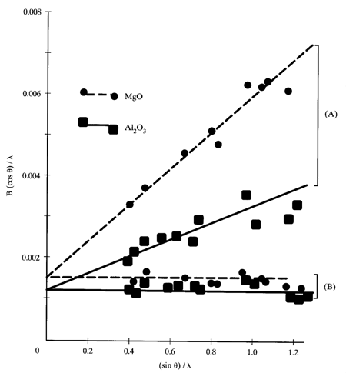
Calibrate the instrument first; leftover broadening is your sample
Characterize instrument shape parameters using a standard
Then U, V, W give the integral breadth for Scherrer and Stokes analysis
  Dv = Kλ / (β cosθ)
  ε = β / (4 tanθ)
  (βobs − βinst) cosθ = λ/Dv + 4ε sinθ
Williamson-Hall: plot βcosθ/λ vs 4sinθ; slope and intercept give strain and size

Slide 41
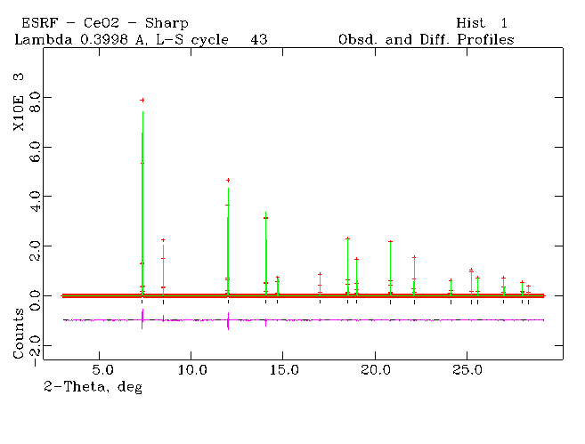
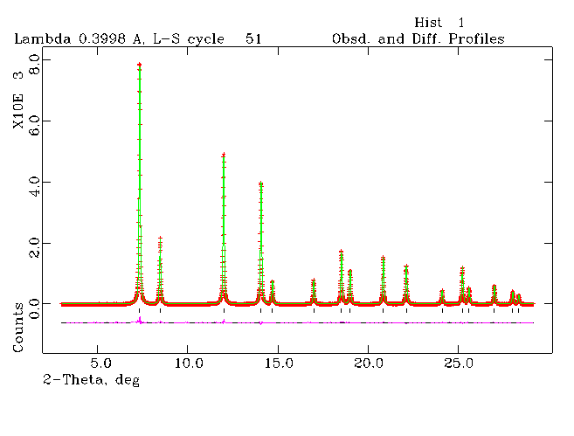
Micronized CeO2 refines to 226 Angstrom domains and 0.011% strain
CeO2 before and after micronizing; volume-weighted domain size Dv = 226 A, maximum strain e = 0.011%

Slide 42
Rietveld refinement is a complete quantitative toolkit
Crystal structure information
  Atomic positions, thermal displacement parameters, occupancy
Beyond the average structure
  Preferred orientation, size, strain, quantitative phase analysis (including amorphous material)
And remember
  Judge fits with the profile plot and chemical sense, not Rwp alone
  Turn parameters on in a correlation-aware order

Slide 43

A second track: scripted and AI-assisted Rietveld
Same data, same physics, written as a script that you can rerun, diff and share
rietx (rietx.org), cross-checked against GSAS-II on every workshop dataset
Notes:
This section introduces a second track for the workshop. GSAS-II stays the tool we learn with. rietx is a Python package that runs the same refinements as a script and attaches diagnostics to every result. Everything in the next slides was run on the same data files you already downloaded, and the notebooks are in the repository.

Slide 44
Manual and scripted refinement are good at different things
Manual: GSAS-II GUI
you click each parameter on
Strengths
+ Builds intuition: every change shows up in the plot
+ Huge scope: single crystal, magnetic, TOF, rigid bodies
+ Your judgment is in every step
Watch out for
− Hard to reproduce: the protocol lives in your head
− Slow for series and batches
− Easy to accept a fit that looks good (negative B, masked regions)
Scripted: rietx, optionally driven by an AI
the refinement is code
Strengths
+ Reproducible: rerun, diff, share the whole protocol
+ Scales: 12 in-situ scans refined both ways in about 2 minutes
+ Diagnostics check every number and say what not to quote
Watch out for
− Follows bad instructions faithfully (reused another instrument's calibration on request)
− Knows nothing about the specimen: spinning, weighing, milling
− An AI assistant can sound sure and be wrong
Learn and explore with GSAS-II; use a script to reproduce, scale up, and get a second opinion.
Notes:
The point of this slide is that these are complements, not competitors. Manual refinement builds intuition: you see each parameter move the pattern. A script makes the protocol explicit and repeatable, scales to many patterns, and rietx adds typed diagnostics that check each number. The cons column on the right is real: a script will happily follow a bad instruction, and an AI assistant can state things confidently that the data do not support.

Slide 45
A refinement becomes a few lines you can rerun, and every result explains itself
import rietx as rx
data = rx.read_pattern("LaB6_Jan2018.raw")
structure = rx.Structure.from_cif("1000055.cif")
instrument = rx.Instrument.bragg_brentano(
radiation="CuKa", goniometer_radius_mm=250)
instrument.background = rx.auto_background(data)
ref = rx.Refinement(structure, instrument)
result = ref.fit(data, plan="lab_calibrate")
print(result) # fit + diagnostics
rx.save_instrument_profile(
ref.fitted_instrument, "lab_profile.json")
What the first fit printed
WARNING BISO_NEGATIVE
B = −2.4 Å²: the column is standing in for something else (roughness, absorption, a bending background)
WARNING FLAT_DIRECTION axial S/L ~ H/L
ρ = −1.000: only their combination is measured; fix one
WARNING HIGH_CORRELATION zero ~ displ.
ρ = +0.999 even with the cell held
WARNING PATTERN_UNDERSAMPLED
4.3 steps per FWHM: a data-collection limit no refinement can fix
Codes, not adjectives: an AI assistant (or a student) can act on each one, and you can check that it did.
Plans encode the turn-on order: lab_calibrate on a standard, then lab_sample_refine on your specimen.
Notes:
This is essentially the whole LaB6 calibration from notebook 01. The plan names encode the turn-on order we discussed earlier: scale and background, then zero and displacement, then W, then U V X Y, then axial divergence, then Biso. The important part is the output on the right: every result carries diagnostics with a code, a location and a suggestion. That is what makes it possible to check an AI assistant's work.

Slide 46
LaB6: negative B in both codes was really surface roughness
Same held cell (4.15695 Å) | GSAS-II | rietx
Biso La, B (Å²) | −1.49, −0.89 | 0.3 held
Surface roughness | none | refined
Zero shift (°) | 0.023 | 0.015
Axial (S+H)/L | 0.046 | 0.042
GoF | 5.36 | 2.30
Durbin-Watson | 0.17 | 0.60
The tell: with B held, intensity was 30 % too strong at 21° and 30 to 40 % too weak above 50°, the signature of a rough surface, not of thermal motion.
A negative B is a symptom. Test what it is absorbing instead of accepting it, or just holding it.
Notes:
Both GSAS-II and rietx gave LaB6 negative displacement parameters. Holding B at a physical value made the fit worse, and rietx's region-by-region report showed why: calculated intensities were 30 percent too strong at low angle and 30 to 40 percent too weak at high angle. We then tested rival physical causes against the data. A variable divergence slit does not fix it, and the file header says the slit was fixed anyway. Surface roughness does, at a Delta BIC of about plus 330. The calibration also agrees with GSAS-II on the instrument terms to roughly the level you would expect from two different peak-shape models.

Slide 47
Al2O3/Si: two codes agree on 3.2 wt% Si; the balance says 10
10.0
3.24
3.16
Candidate | Test | Verdict
Amorphous content | internal-standard arithmetic: −217 % amorphous | ruled out
Microabsorption | Brindley, 50 µm Si: 3.2 → 3.8 wt% | too small
Biso choice | held at physical values: 3.6 wt% | 0.5 wt%
Particle statistics | Si 311 at 2.15×, unspun specimen | supported
wt% Si weighed
wt% Si, GSAS-II
wt% Si, rietx
Two codes agreeing is precision, not accuracy.
Fix it in the lab: spin the specimen, use fine Si, measure several mounts.
The tool did not just report 3.2 wt%; it helped rule causes in and out.
Notes:
Two independent codes agree to within 0.1 weight percent, and both disagree with the balance by a factor of three on the silicon. Agreement between codes is not accuracy. The chart is the key evidence: for each silicon reflection, how far the observed intensity sits from the calculated one. In the 90/10 mount the 311 is more than twice its calculated value and 331 is 38 percent low. Counting errors are a few percent. A second mount on the same instrument sits within 10 percent everywhere. Microabsorption or amorphous content would scale every reflection by the same factor, so this scatter points at particle statistics: coarse silicon in an unspun specimen. Amorphous content is actually ruled out by arithmetic: it would make silicon read high, not low.

Slide 48
Co3O4: one script refines a 12-scan heating and cooling cycle, and checks itself
What the script found
“Impurity” peaks are Co Kβ
no filter in the beam; modelled, not masked (GoF 2.0 → 1.3 at 25 °C)
Order-independent
chain run forward and backward: no parameter disagrees
Hysteresis
cooling stalls near 94 % (±3 wt% from the minor phase's B)
Matches the older GSAS figure
point for point, plus a first cooling scan at 880 °C
A series is where scripting pays off most: same protocol on every scan, plus checks no one does by hand.
Notes:
Twelve in-situ scans from 25 to 1000 degrees and back, refined in one script. Each scan is warm-started from the previous one, the whole chain is run forward and backward to check that the answer does not depend on the order, and flagged jumps are refit independently. Heating: CoO oxidises to spinel and is fully converted by 820 to 880 degrees, then at 1000 degrees the spinel decomposes completely to CoO. Cooling: CoO re-oxidises, but stalls at about 94 percent. The peaks that were excluded as an impurity in the GSAS-II refinement are cobalt K-beta lines, so here they are modelled as a third emission line instead of thrown away.

Slide 49
Where the scripted pass caught what my GSAS-II refinements missed
Dataset | My GSAS-II refinement | What the scripted pass found | How it was caught
LaB6 standard | B < 0 on both sites, GoF 5.4 | surface roughness; B = 0.3 Å², GoF 2.3 | BISO_NEGATIVE, then an intensity-vs-angle trend and rival tests
Al2O3 / Si / SiO2 | quartz modelled (0.4 wt%), Uiso ≈ −1.9 Å², GOF 5.5 | a broad fluorite-type phase (a = 5.10 Å), most likely ZrO2 from milling; GoF 3.5 → 1.5 | add_impurity_phase (confidence 0.9), unmatched broad peaks
Co3O4, 25 °C | 5 regions excluded as an impurity | they are Co Kβ lines; modelled, GoF 1.3 | positions of Kβ copies of every reflection
Co3O4, 1000 °C | 99 % Co3O4, a = 8.230 Å, GOF 7.9 | 100 % CoO: the spinel is gone (wrong basin) | warm-started series, then an independent cold refit
All four were quick teaching refinements, not final analyses: the kind of fit a busy expert accepts.
The script never gets tired or satisfied: every negative B, unmatched peak and wrong basin gets reported.
Notes:
Full disclosure: these four refinements in the repository are mine. They were quick teaching refinements, not final analyses, but they are exactly the kind of fit a busy expert accepts. Running the same data through a diagnostic-driven script caught all four. The common thread is that the script does not get tired or satisfied: it reports every negative B, every unmatched peak, every wrong basin, and it tests alternatives systematically. That is context a human can miss on a fast pass.

Slide 50
It also made mistakes, and only executed numbers caught them
The AI's draft claims that were wrong
“Axial divergence agrees with GSAS-II within 1 %”
at the same held cell: 9 % apart
“The minor phase's B moves fractions < 1 wt%”
measured: 2.5 wt%
“The second mount's Si scatters too”
it sits within 10 %
“The held cell moves the zero by a few thousandths”
0.009°, and χ² 30 % lower
Blind spots of the tool
Reused a LaB6 calibration from another diffractometer
because it was asked to; only FLOOR_HIT hinted
Its own cold-refit check called a real phase change an artefact
the cold start was outside the fit's reach
Refused an unusual GSAS .prm file
a human had to decide what to drop
Cannot see the sample prep
spinning, weighing, milling media are yours
Treat it like a fast, tireless, overconfident graduate student: check every claim against a number it computed.
Notes:
The flip side, from the same project. The AI assistant drafted the notebooks' explanations before running the code, and four of its claims were wrong when the numbers came back. Every one was caught only because each claim was checked against an executed result. The tool itself also has blind spots: it reused a calibration from a different diffractometer because it was told to, one of its own self-checks mislabelled a real phase change, and it cannot know anything about how the specimen was prepared. Treat it like a fast, tireless, overconfident graduate student.

Slide 51
Try it: three notebooks on the workshop data, readable on GitHub as is
01
LaB6 instrument calibration
lab_calibrate, a negative-B hunt, and a saved instrument profile
02
Al2O3/Si phase analysis
QPA, GSAS-II side by side, and why 10 wt% reads as 3
03
Co3O4 temperature series
12 scans refined both directions; phase fractions and cells vs T
github.com/sp8rks/Ceramic_Rietveld_Refinement → scripted refinement (rietx)
Run: pip install -r requirements.txt then open the notebooks in JupyterLab (Python ≥ 3.11)
With Claude Code: “Refine LaB6_Jan2018.raw with rietx and explain the diagnostics” (the rietx skill ships in the repo)
Suggested exercise: refine one dataset in GSAS-II yourself, then run the notebook and compare numbers and diagnostics. Where you disagree, find out who is right.
Notes:
Everything shown in this section is in the repository, in the folder 'scripted refinement (rietx)'. The notebooks are saved with their outputs, so students can read them on GitHub without installing anything. To run them: Python 3.11 or newer, pip install the requirements file, and open JupyterLab. Run notebook 01 first, because it writes the instrument profile notebook 02 uses. The repository also contains the rietx skill for Claude Code, so students can ask Claude to refine a pattern and it will follow the same protocol and diagnostics.

